Slide 1
Chem 108: Lab
Week 12
Sign in
Alcohol Distillation
To do with your Fermentation partner:
Turn in 7-Solution Report form
and
Post Lab Questions

Slide 2
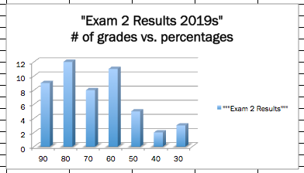


Slide 3
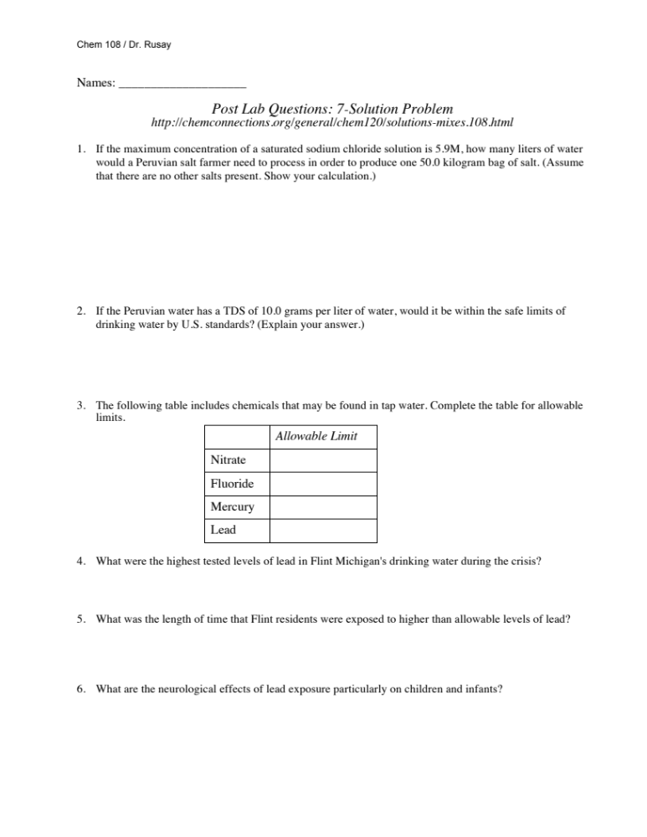
7 Solutions Report pp. 76-80
& Post Lab Questions
Due Today

Slide 4
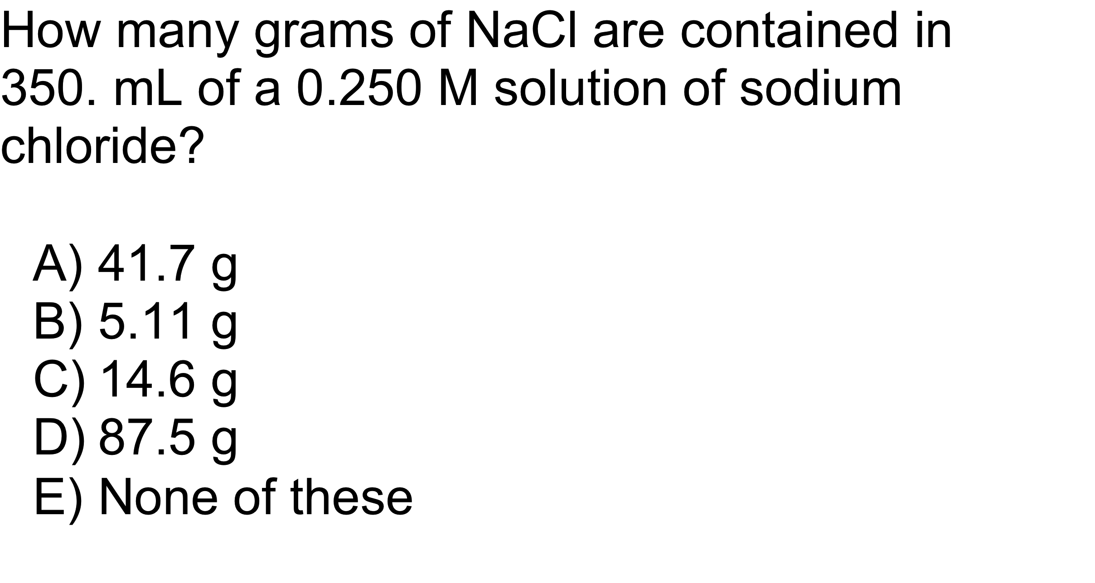
QUESTION
Seven Solutions Post Lab Questions
http://chemconnections.org/general/chem120/solutions-mixes.108.html
Solutions: molarity & volume → mass

Slide 5
ANSWER
B)
5.11 g
Seven Solutions Post Lab Questions
http://chemconnections.org/general/chem120/solutions-mixes.108.html
Volume
(L) times concentration
(mol/L) gives
moles. Moles are then converted to grams multiplying by the molar mass.

Slide 6
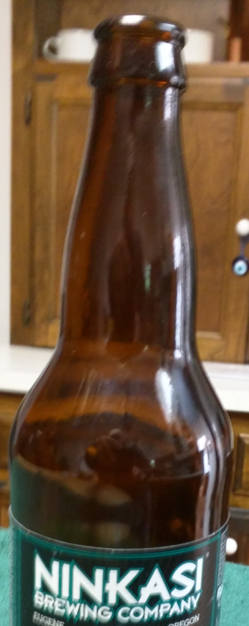
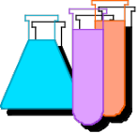
Chemical Reactions
To DO Today
Separating the Ethanol Produced
  Fermentation / Distillation pp.63-67
_________________________
http://www.piney.com/BabNinkasi.html)
Notes:
A 3900-year-old clay tablet, which was found in Iraq between the Tigris and Euphrates rivers, had a Sumerian poem (http://www.piney.com/BabNinkasi.html) honoring Ninkasi, the patron goddess of brewing. It contains the oldest surviving beer recipe, describing the fermentation of the carbohydrates found in bread, bappir, made from barley, honey, dates and sweet aromatic herbs. The global availability of carbohydrates and native microbes (yeasts) has led to the production of many different types of beers, ales, wines, and fruit based alcoholic beverages in many countries throughout the world. [The bottle on the left was found in Eugene, Oregon, ……. But, it dates only to 2016.]

Slide 7
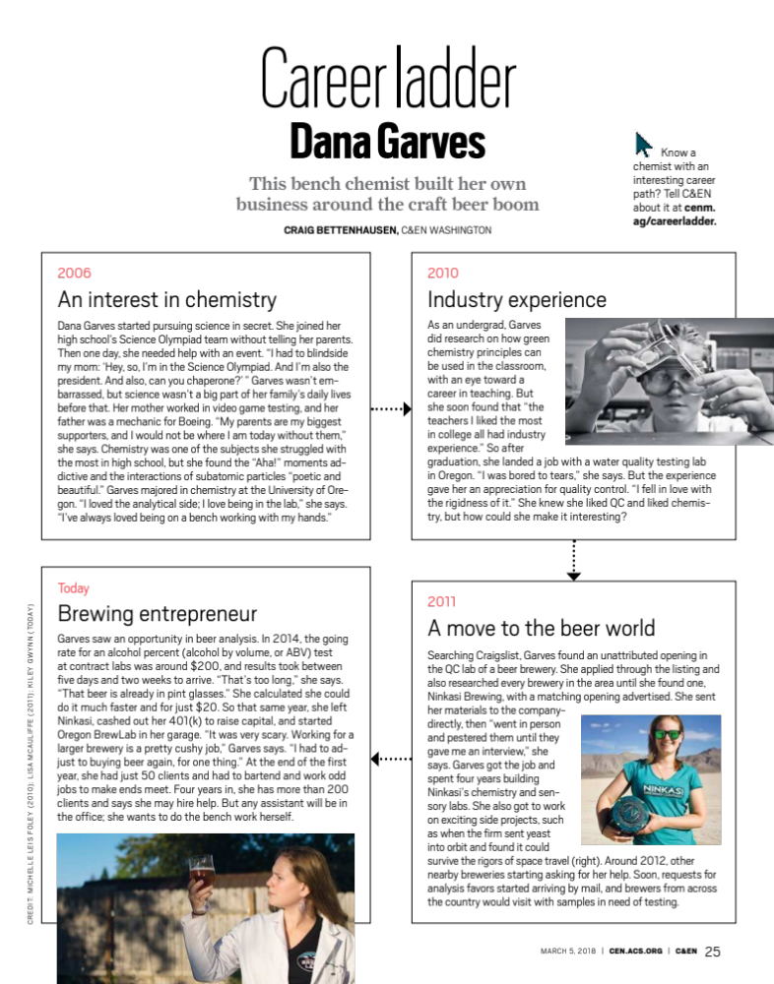
http://chemconnections.org/general/chem108/Beer-Ninkasi-Dana%20Garves.pdf
Biological Reactions: Enzyme Catalysts
  Fermentation / Distillation
Notes:
A 3900-year-old clay tablet, which was found in Iraq between the Tigris and Euphrates rivers, had a Sumerian poem (http://www.piney.com/BabNinkasi.html) honoring Ninkasi, the patron goddess of brewing. It contains the oldest surviving beer recipe, describing the fermentation of the carbohydrates found in bread, bappir, made from barley, honey, dates and sweet aromatic herbs. The global availability of carbohydrates and native microbes (yeasts) has led to the production of many different types of beers, ales, wines, and fruit based alcoholic beverages in many countries throughout the world. [The bottle on the left was found in Eugene, Oregon, ……. But, it dates only to 2016.]

Slide 8
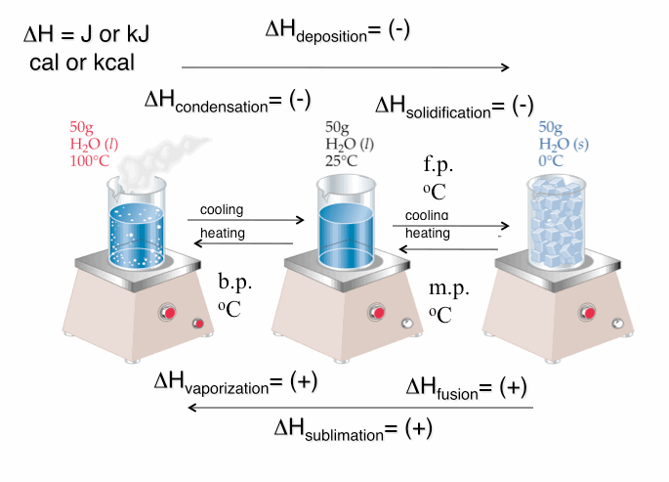
Energy: Heat: Enthalpy (ΔH)

Slide 9
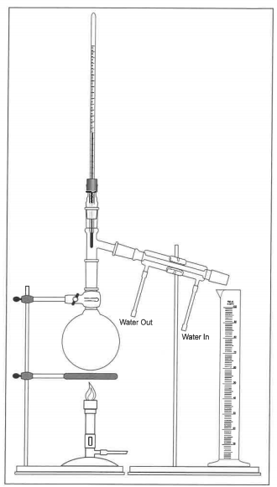
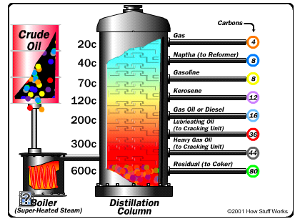
Distillation
http://chemconnections.org/general/movies/html-swf/oil-refining.swf
Oil Refining:
http://science.howstuffworks.com/oil-refining4.htm

Slide 10
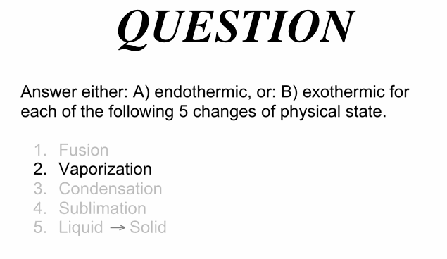
A) endothermic

Slide 11
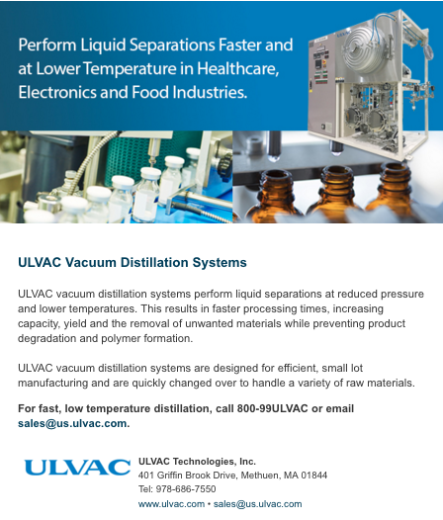
Distillation involves heating.
How could distillation be done @ lower temperatures?
One of many products being sold.

Slide 12
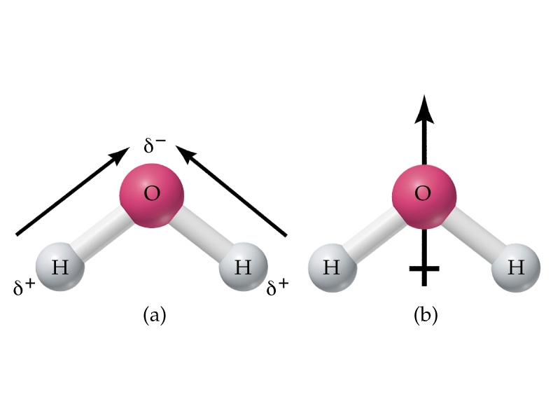
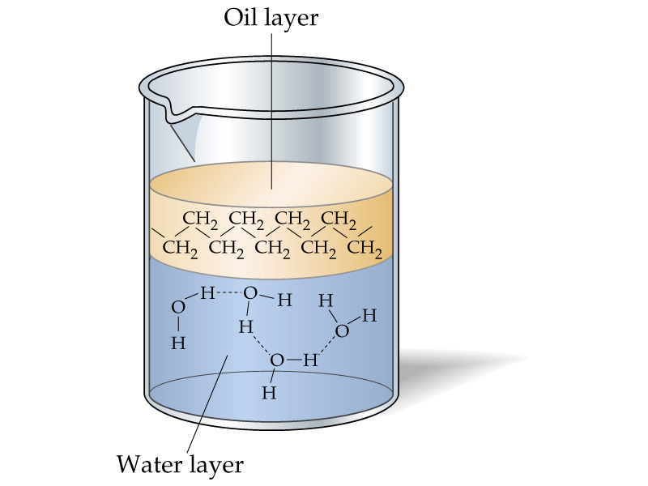
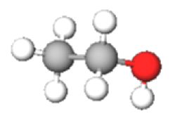
Water : “The Universal” Solvent
The ethanol product is miscible in water and both vaporize when the solution is distilled.

Slide 13
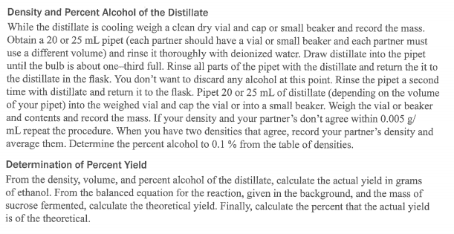

Theoretical & Percent Yield
http://chemconnections.org/general/movies/html-swf/oil-refining.swf
The ethanol produced in the fermentation is distilled along with the water used. The liquid collected is ethanol mixed in with the water, which is the solvent. The amount dissolved will be calculated by experimentally determining the solution’s density.
What is a solution’s concentration?

Slide 14
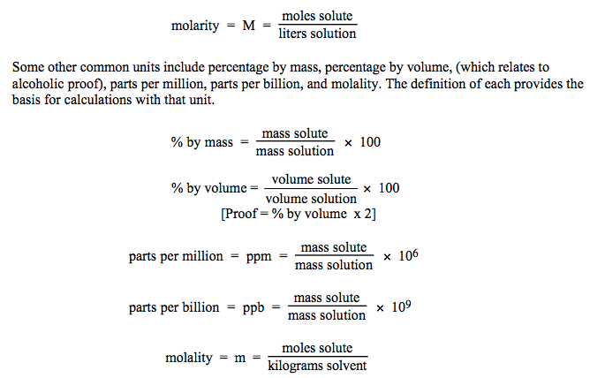
Solution Concentrations
Concentration is a measure of the amount of solute dissolved.

Slide 15
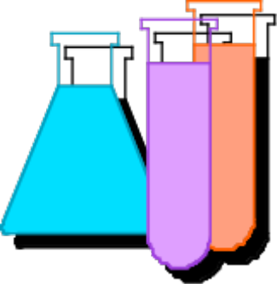
Solution Concentrations
Concentration in mass percent is common.
Mass % = Mass solute / [Mass solute + Mass solvent ] x100
What is the mass % of 65.0 g of glucose dissolved in 135 g of water?
Mass % = 65.0 g / [65.0 + 135]g x 100
= 32.5 %

Slide 16
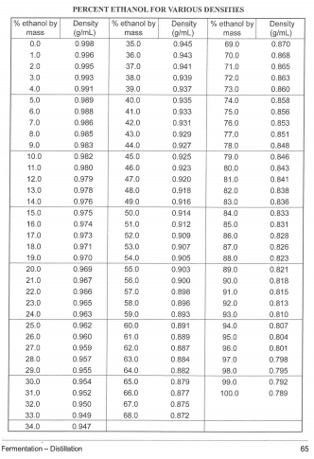
% Ethanol from Density

Slide 17
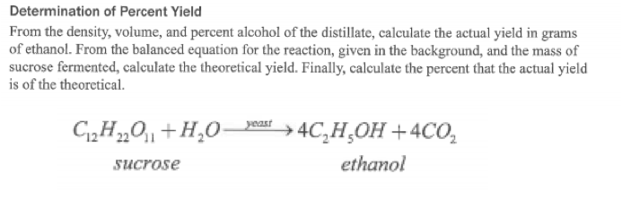

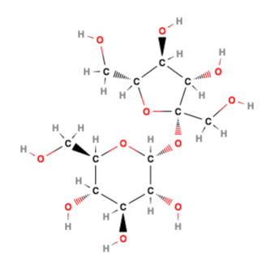
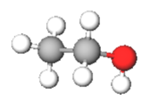
Calculations

Slide 18
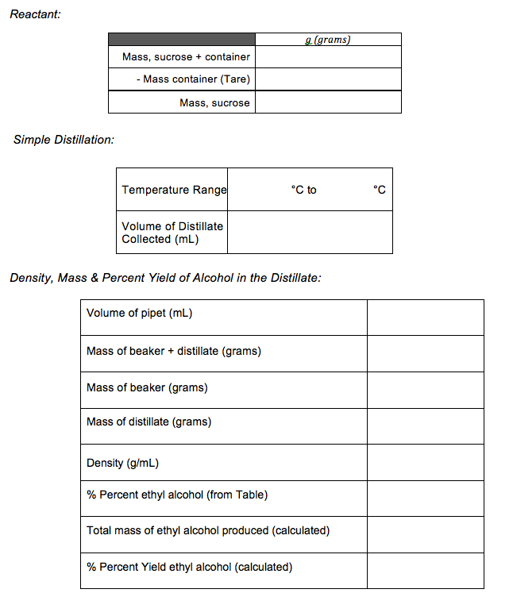
Example
24.55 g
52.2 mL
9.90 g/ 10.00mL
0.990 g/mL

Slide 19
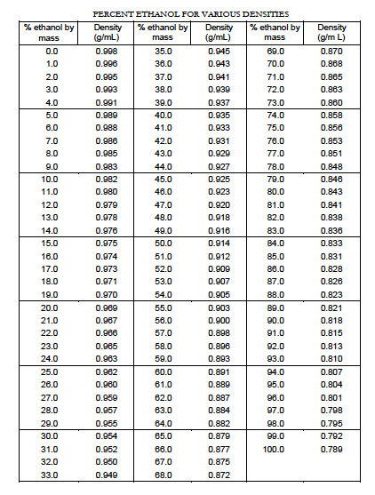
Example
24.55 g
4.5 %
52.2 mL
0.990 g/mL

Slide 20
Theoretical Yield Calculation
24.55 g
? g (theoretical)
4
Molar mass = 342.3 g/mol
Molar mass = 46.07 g/mol
? mol sucrose = 24.55 g / 342.3 g/mol
= 0.07172 mol
? mol C₂H₅OH = 4 x mol sucrose
= 0.2869 mol
? g (theoretical) = mol C₂H₅OH x 46.07 g/mol
= 13.22 g
__________________
? g (actual) = [4.5 % ,that is: 4.5/100] x 52.2 mL x 0.990 g/mL
= 2.33g
% Yield = g (actual) / g (theoretical) x 100
= 17.6 %

Slide 21
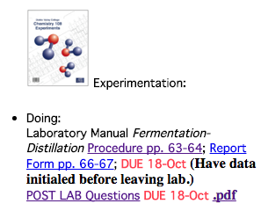
Theoretical & Percent Yield
Doing:
Laboratory Manual Fermentation-Distillation Procedure pp. 63-64; Report Form pp. 66-67; DUE: Next Week (Show Dr. R. distillate before disposing down the drain & have data initialed before leaving lab today.)
POST LAB Questions DUE: Next Week Pick up Handout

Slide 22
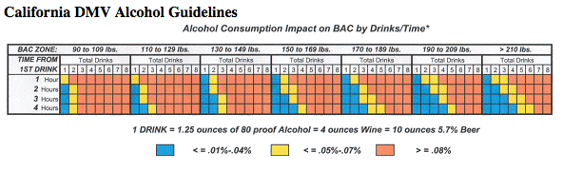
POST LAB Questions DUE: Next Week
http://chemconnections.org/general/chem120/ethanol-ques-108.htm
https://www.youtube.com/watch?v=P--6LEbksds

Slide 23
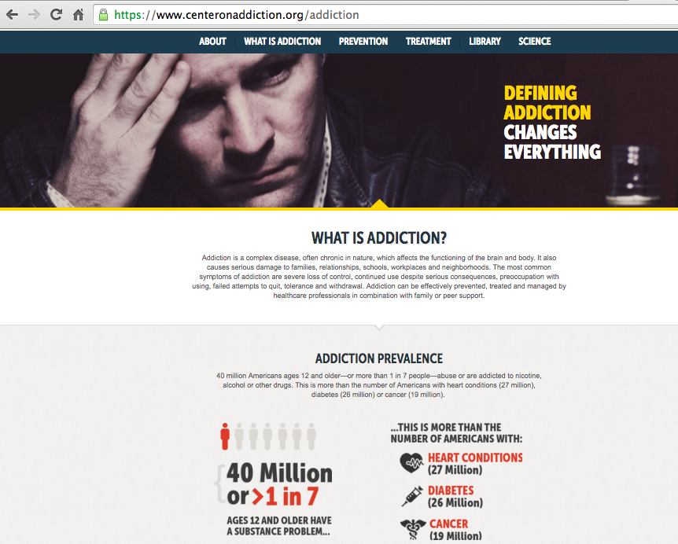
https://www.centeronaddiction.org/

Slide 24
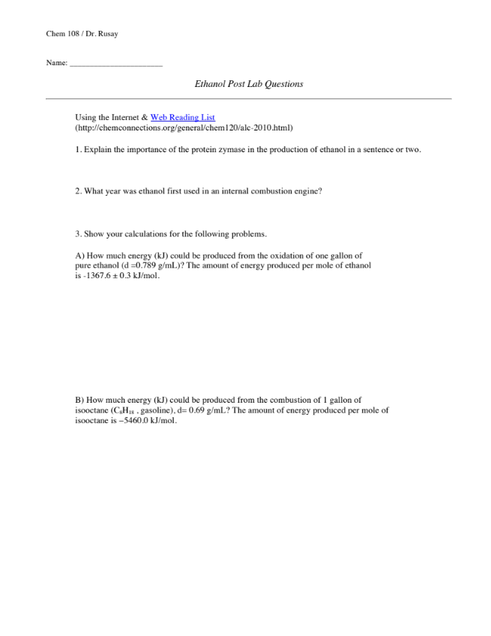
POST LAB Questions; Handout
Turn in Next Week
http://chemconnections.org/general/chem120/ethanol-ques-108.htm

